Slide 1


Development of Low-Cost Methods for Monitoring & Early Warning for Geohazards
RISE Project ID: 2023-02-027
Demonstration Of Devices
Research and Innovation Centre for Science and Engineering (RISE)
BUET, Dhaka-1000
Department of Civil Engineering
Department of Electrical & Electronics Engineering
BUET, Dhaka-1000

Slide 2
Objectives
Development of a low-cost accelerometer/vibrometer with alert transmitting capability
Development of low-cost inclinometer with alert transmitting capability
Development of early warning systems
Collection of field data

Slide 3
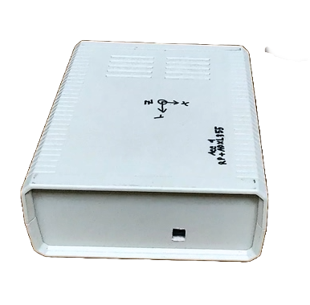
BUET Low-Cost Accelerometer
Features
Plug and play (after initial configuration)
Record data at 100 SPS (24 x 7)
Stay connected to wireless network
Periodically upload data to the cloud
Send warnings when threshold acceleration crossed
Data can be accessed remotely
Configuration can be updated remotely

Slide 4




























Accelerometer Program Architecture

Slide 5
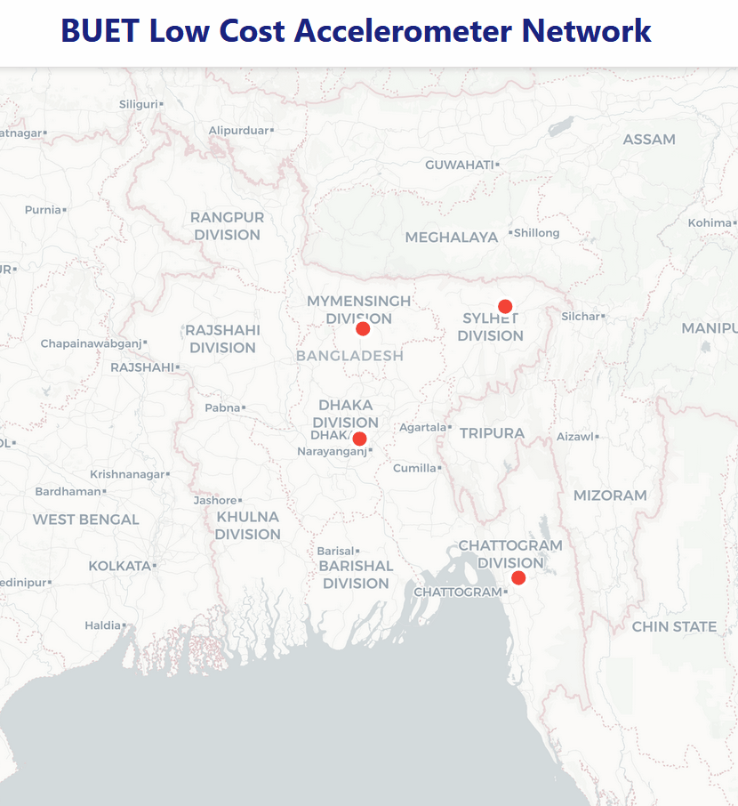
BUET Low-Cost Accelerometer Network
BUET, Dhaka
SUST, Sylhet
BAU, Mymensingh
CUET, Chattogram
Locations

Slide 6
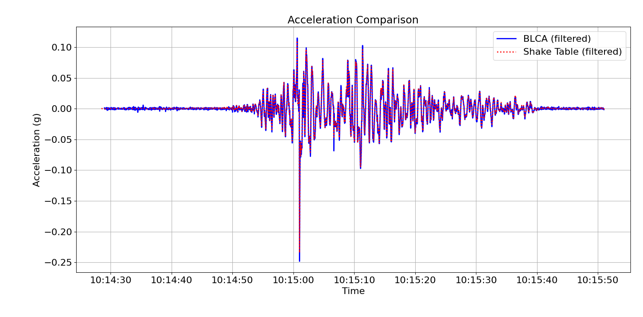
Accelerometer Calibration Test
Figure: Simulation of Chi-Chi Earthquake on Shake Table at CUET

Slide 7
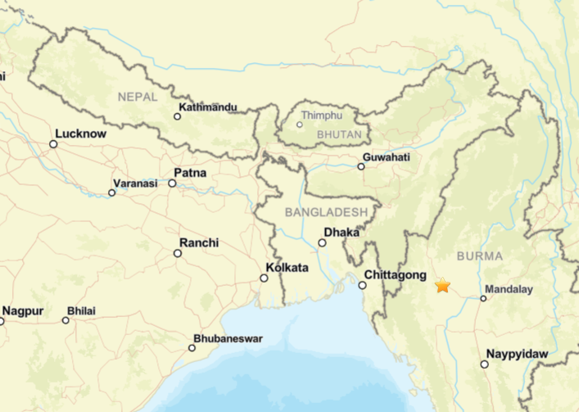
Record of a Recent Earthquake
Time: 2025-07-31 14:26:48 (UTC)
Location: 22.335°N 94.646°E
56 km WNW of Monywa, Burma (Myanmar)
Depth: 123.1 km
Source: https://earthquake.usgs.gov/earthquakes/eventpage/us6000qwy4
Magnitude: M 4.8

Slide 8
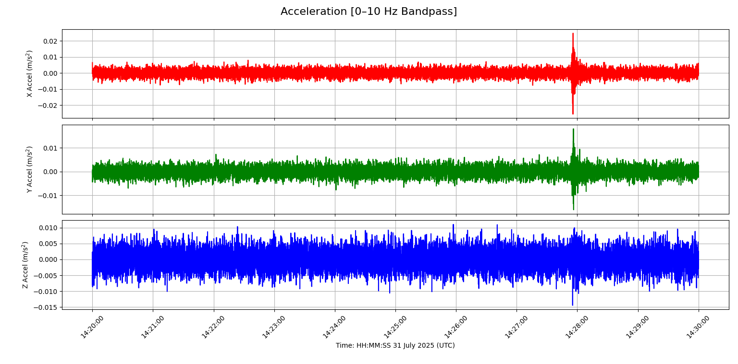
Record of Recent Earthquake (CUET Station)

Slide 9
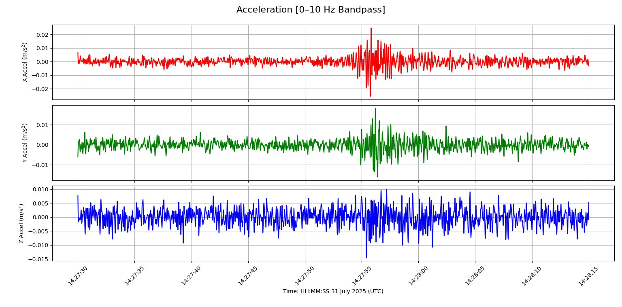
Record of Recent Earthquake (CUET Station)

Slide 10
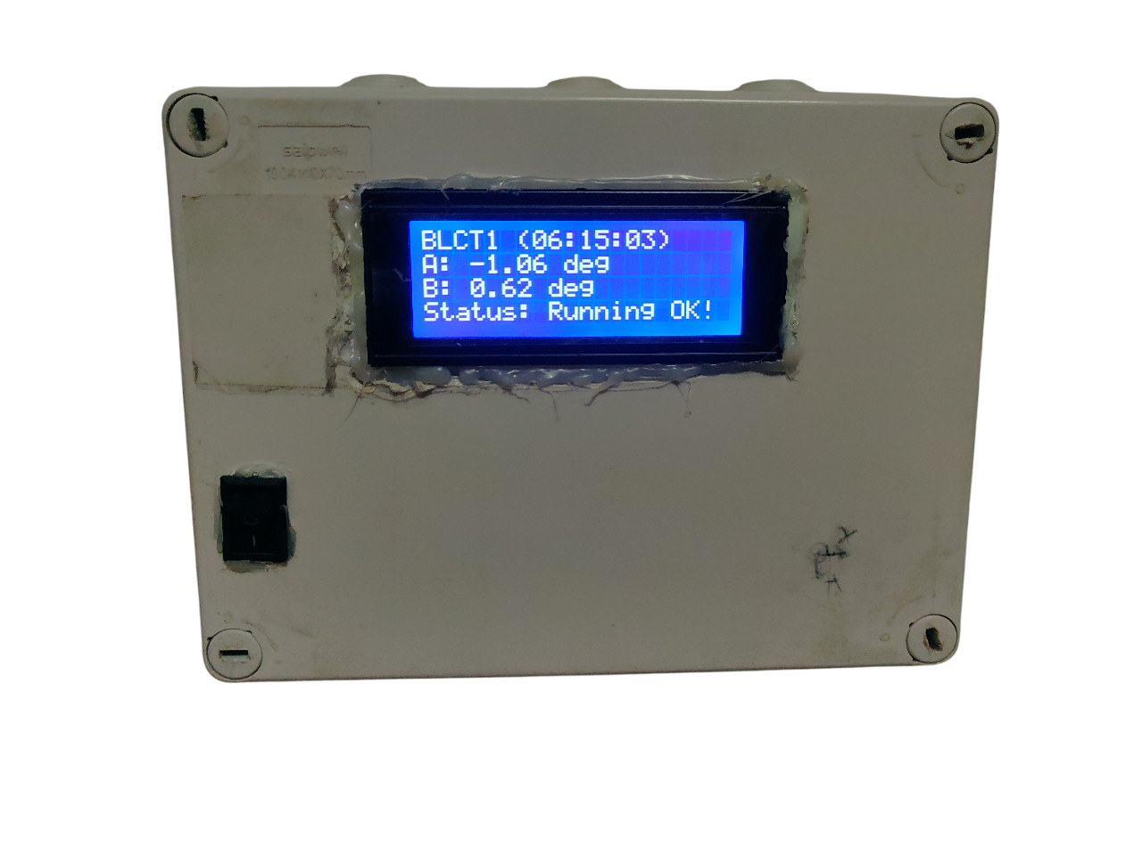
BUET Low-Cost Tiltmeter (Inclinometer)
Features
Plug and play (after initial configuration)
Process data at 1 SPS (24 x 7)
Stay connected to wireless network
Periodically upload data to the cloud
Send warnings when threshold angle crossed
Data can be accessed remotely
Configuration can be updated remotely
Integrated UPS (3 hours backup)
Realtime battery health

Slide 11
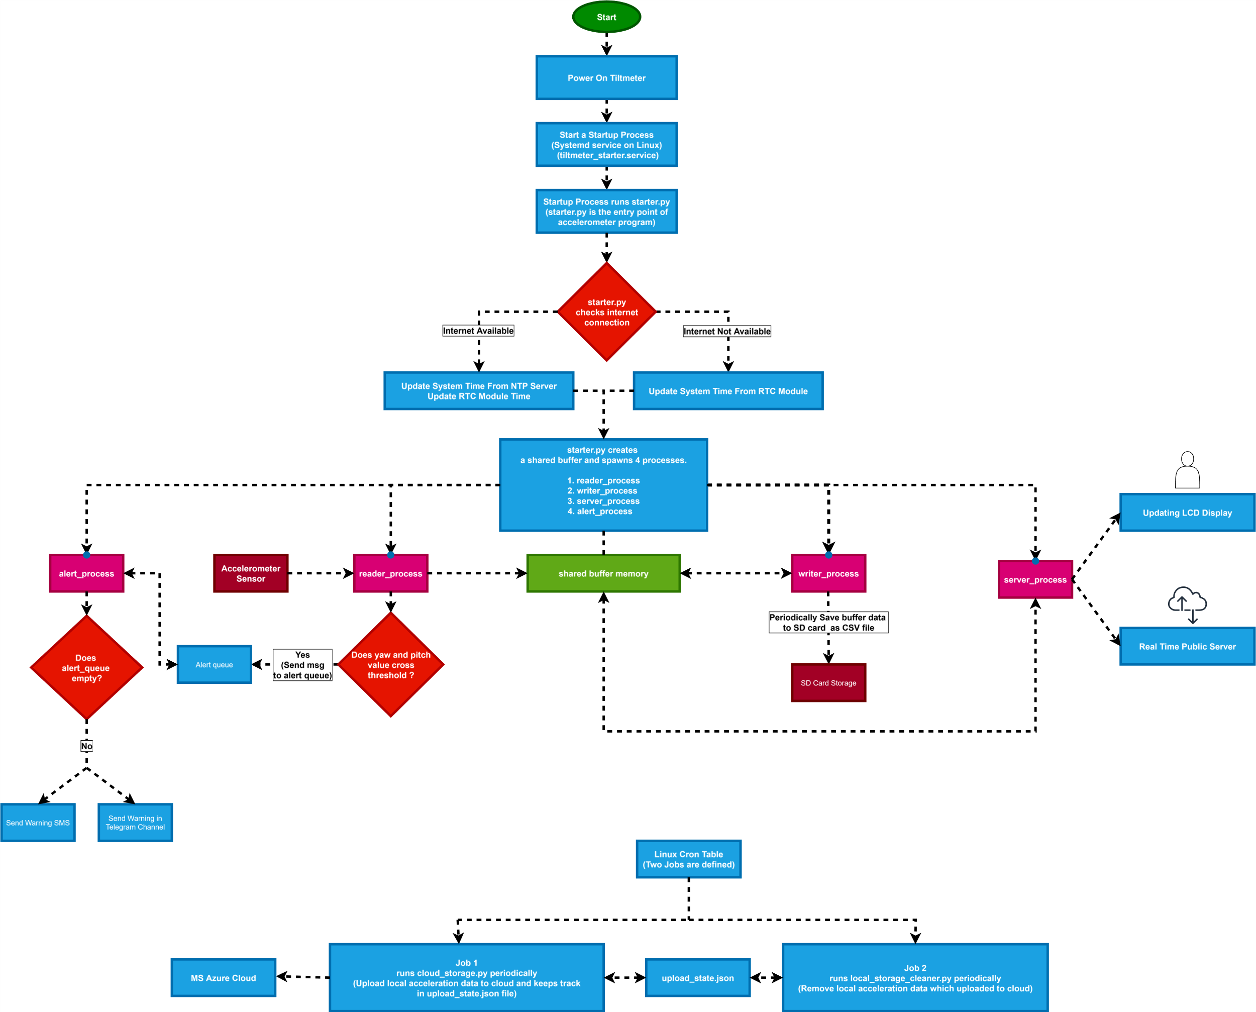
Tiltmeter Program Architecture

Slide 12
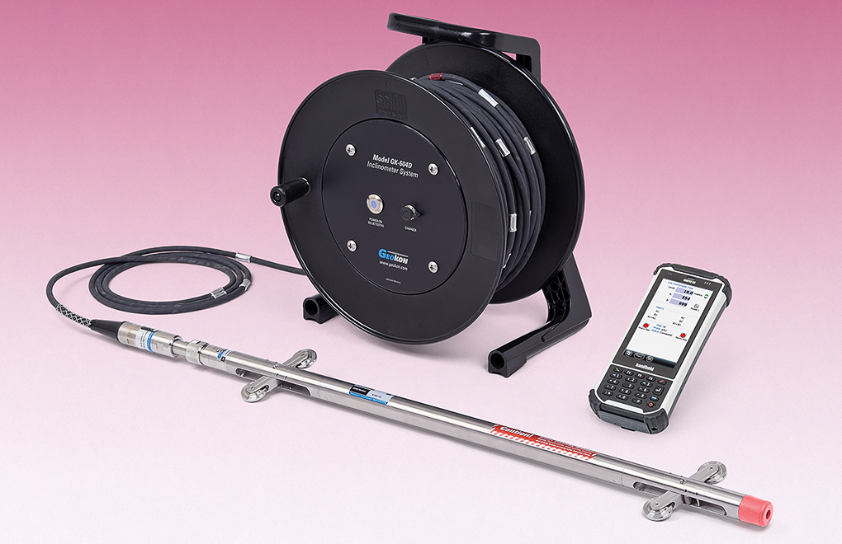
Development of Inclinometer
Data Collection Using Inclinometer
Via a data logger
Or an Android-based device
Sensor in probe and processing in drum
Inclinometer components

Slide 13
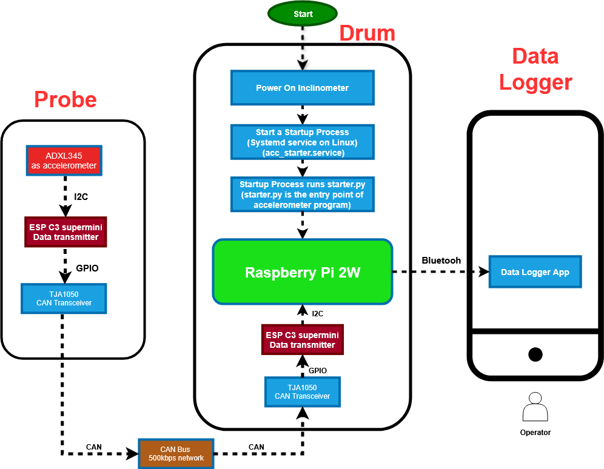
Manual Inclinometer (Incomplete)

Slide 14
THANK YOU

Slide 15
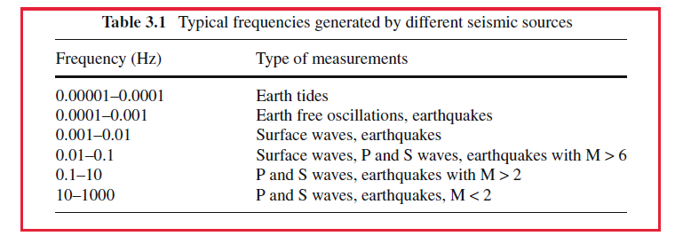
Frequency Range of Seismic Sources

Slide 17
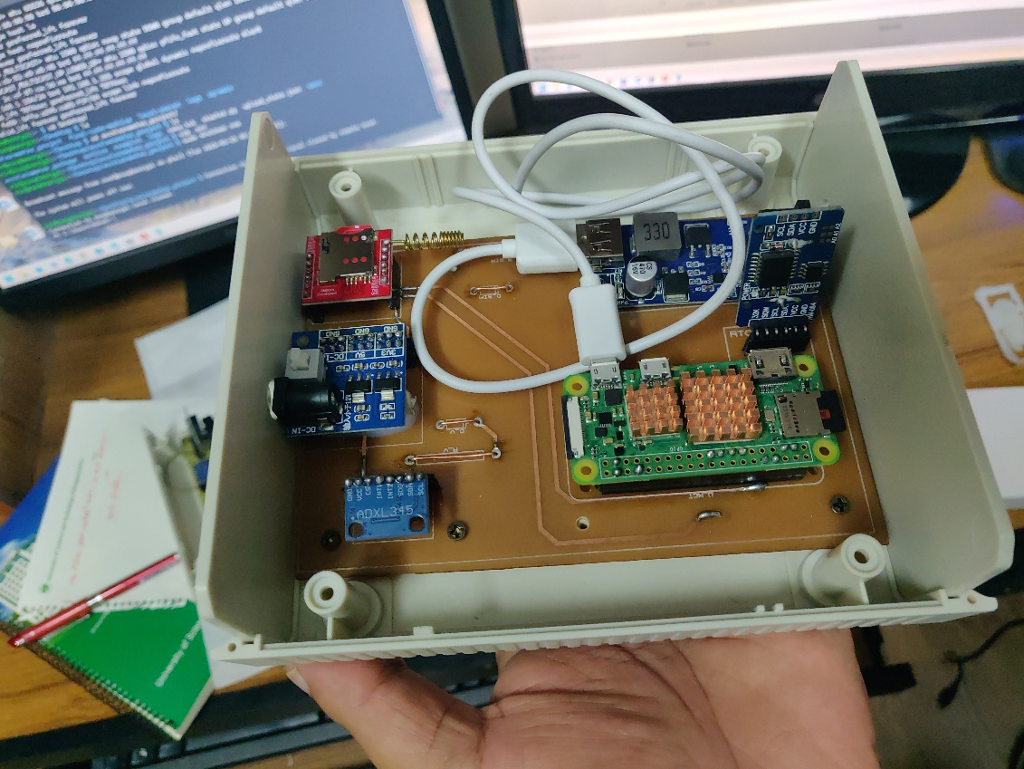
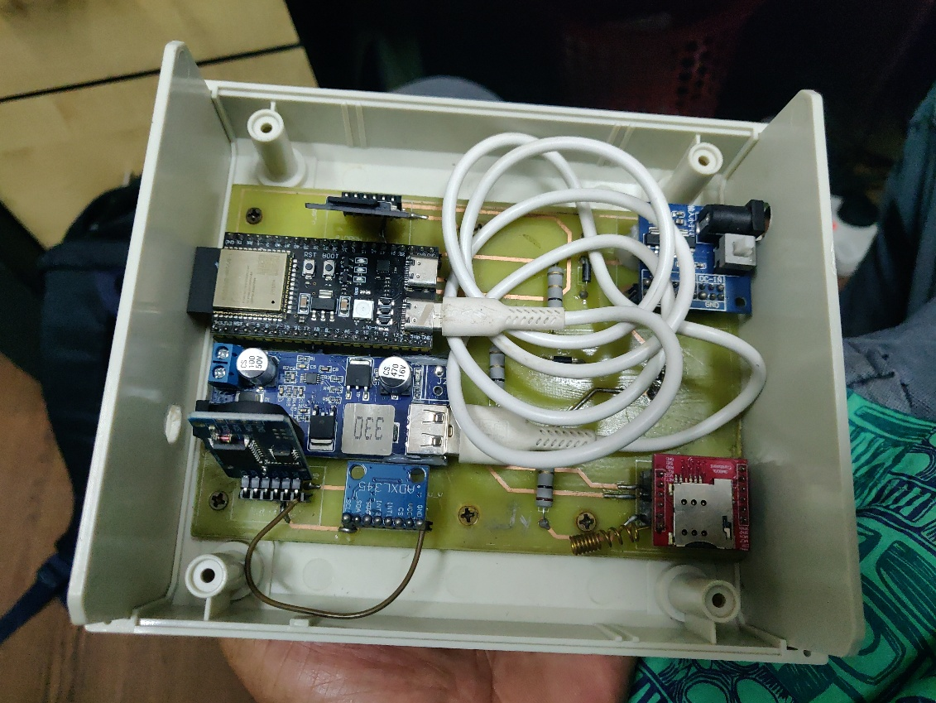
Initial Prototypes
Device 1
Device 2

Slide 18
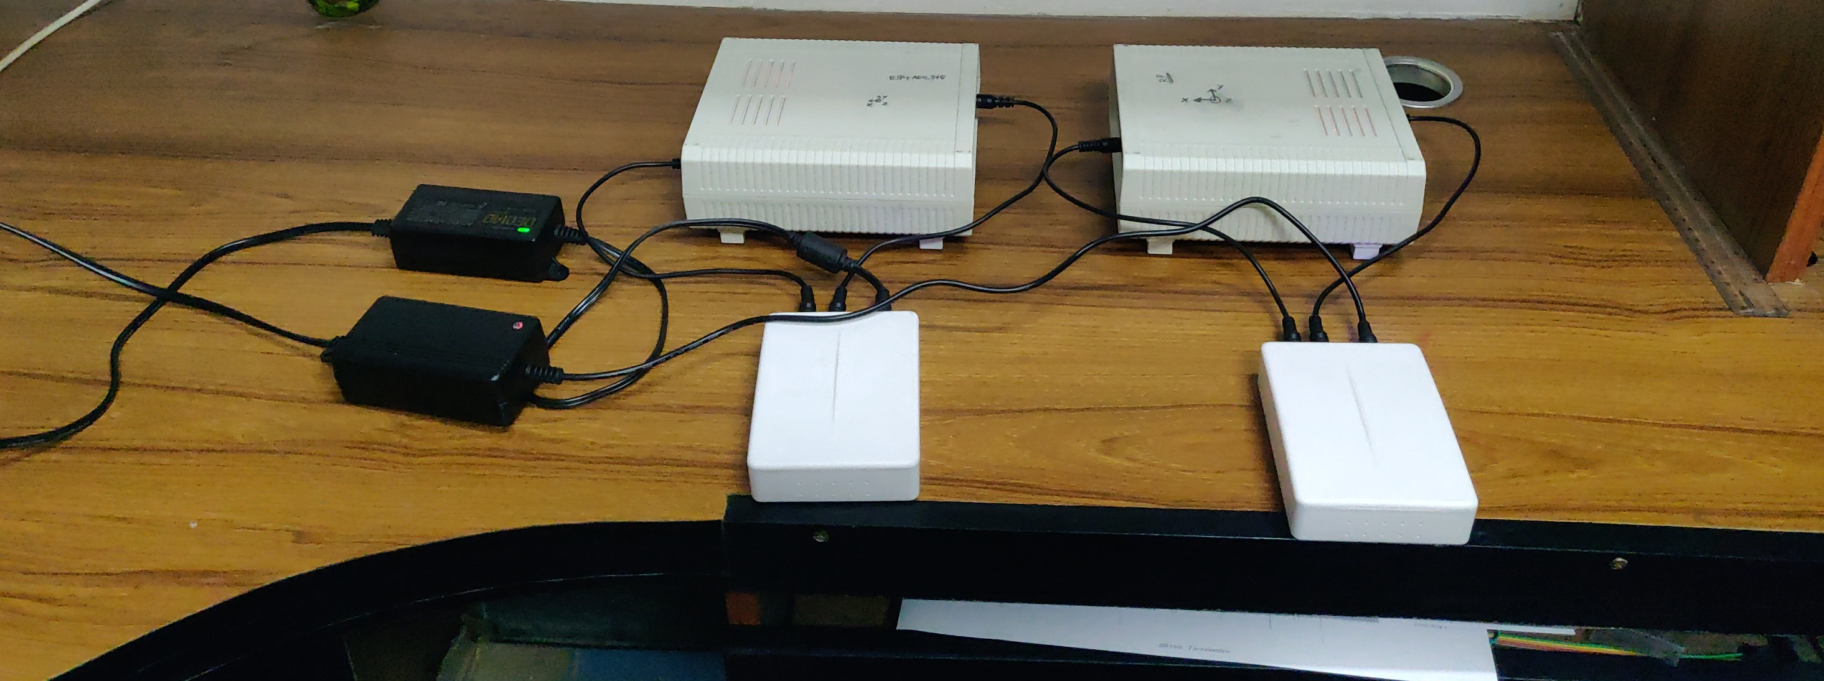
A complete setup of 2 devices

Slide 20
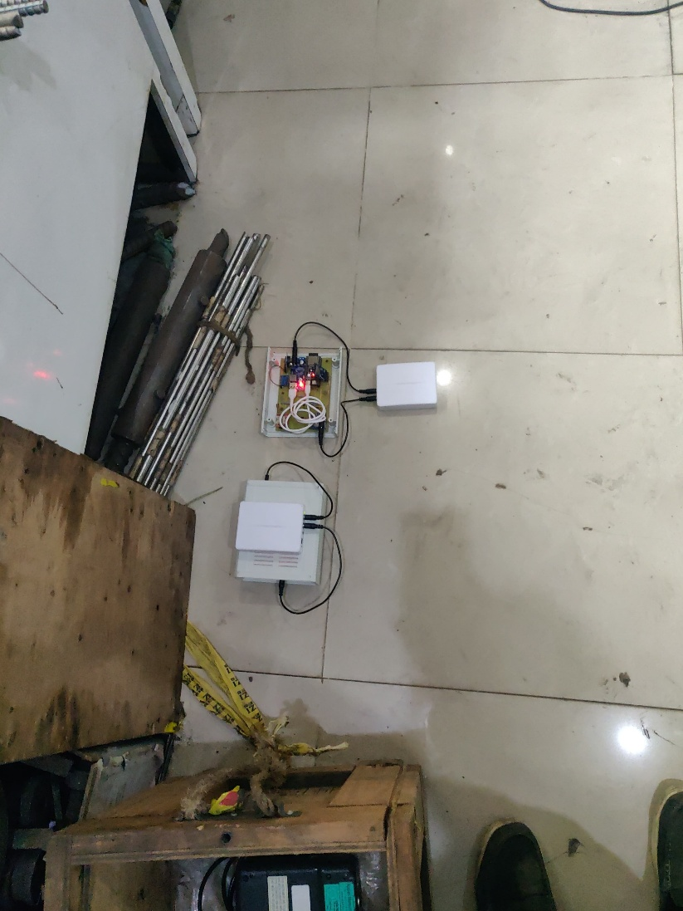
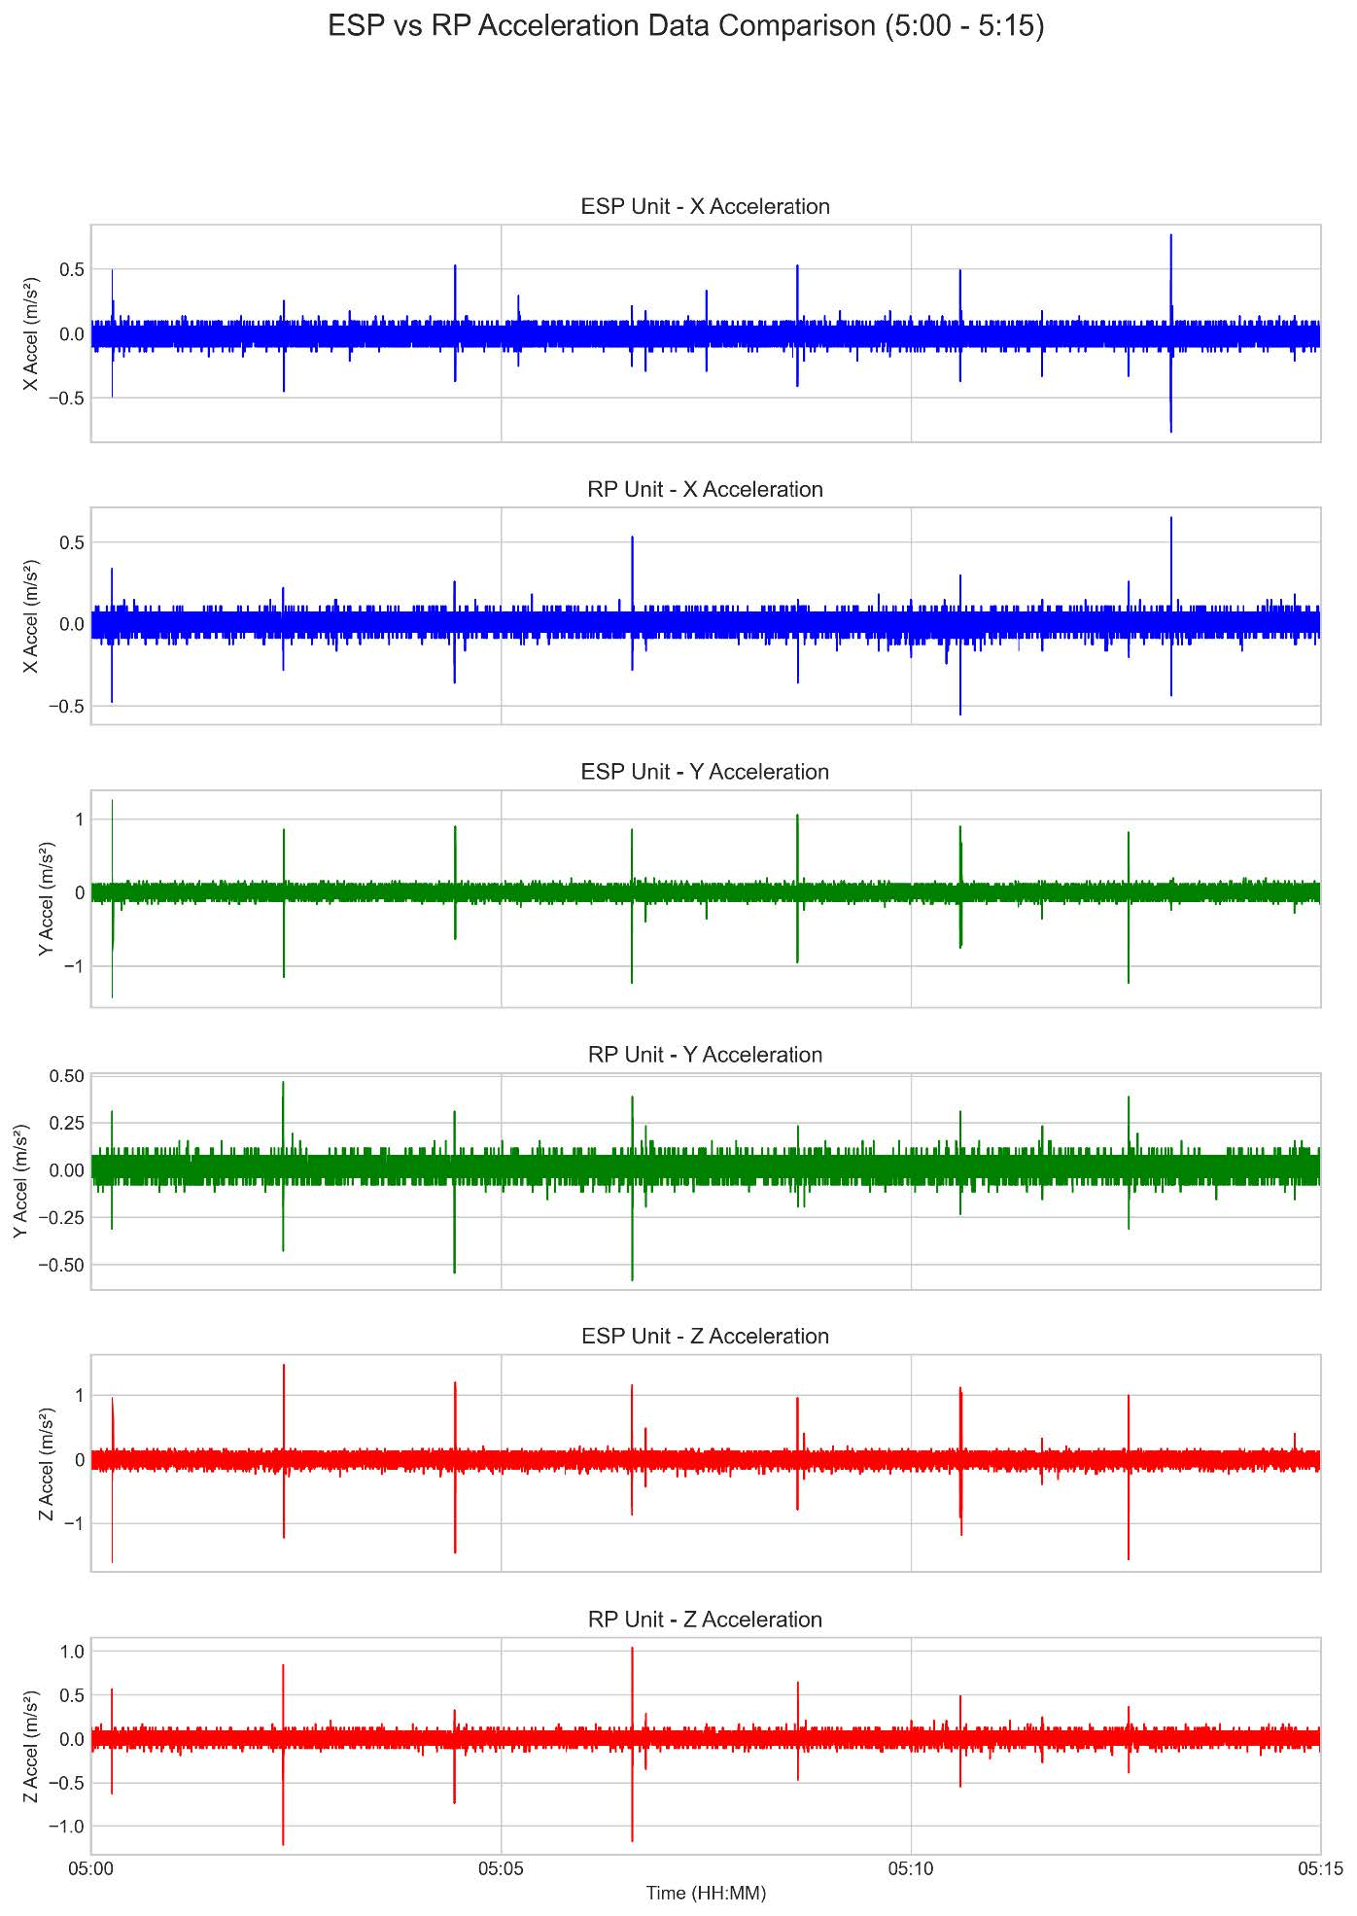
Performance Report
Two devices recorded acceleration during the rod test
Acceleration captured at the moment of rod failure
Both devices recorded data at the same timestamp
Recorded acceleration magnitudes differ between devices

Slide 21
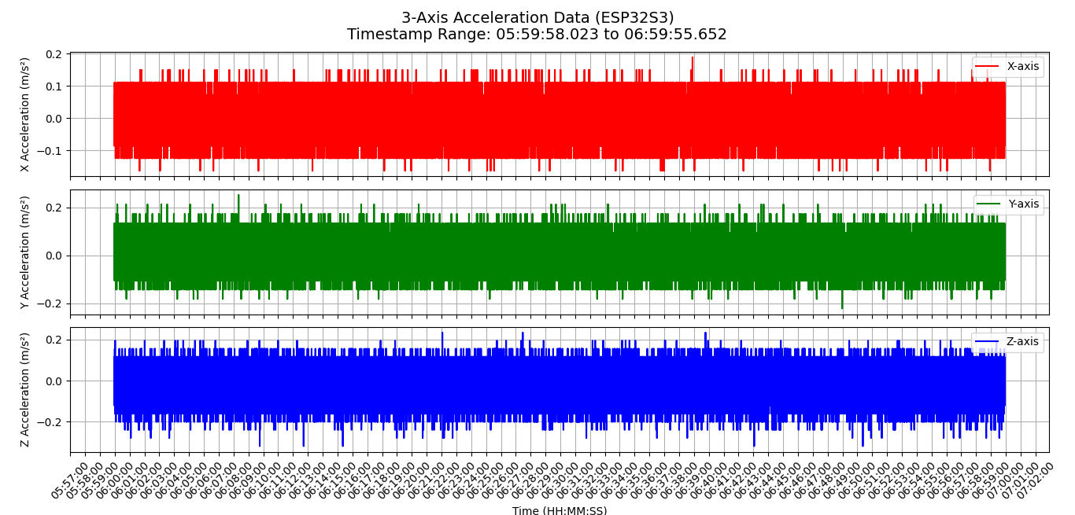
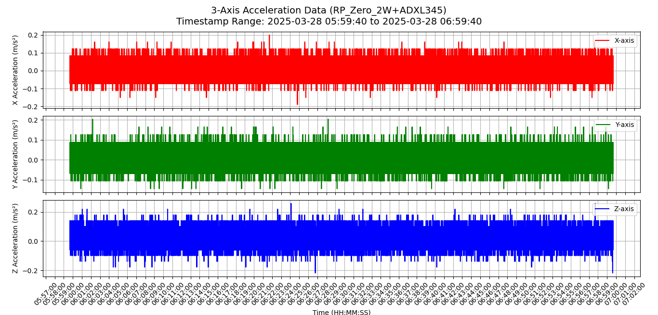
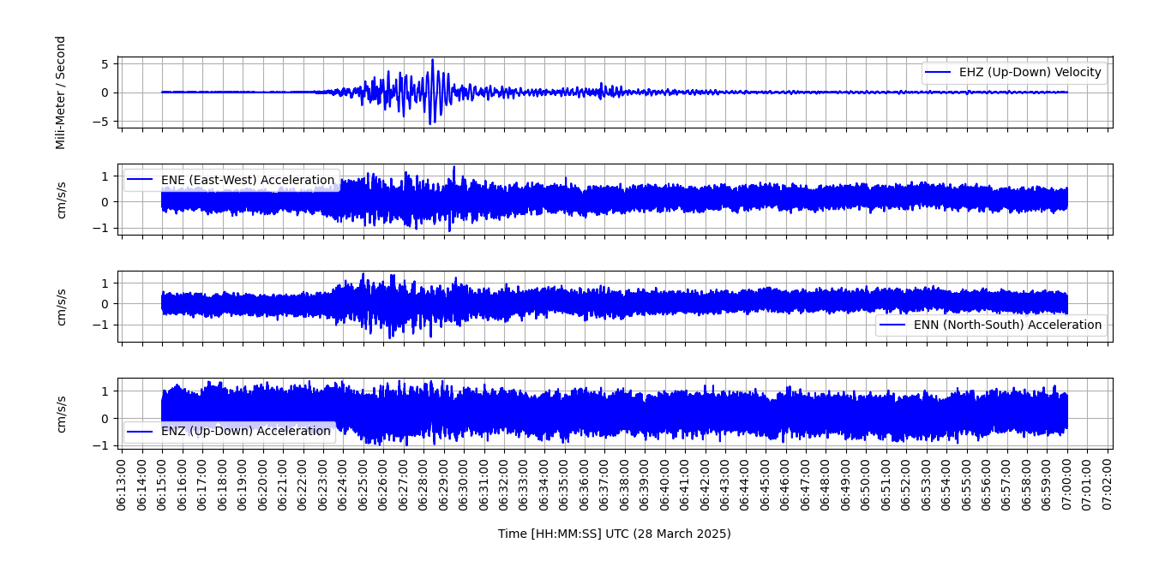
Data recording report from 26 March to 4 April 2025
Date: March 28, 2025 Time (UTC): 06:20:54 Magnitude: 7.7 Location: Myanmar Distance from BUET: 598 km
Recording: Raspberry Shake vs Device 1 & 2

Slide 22
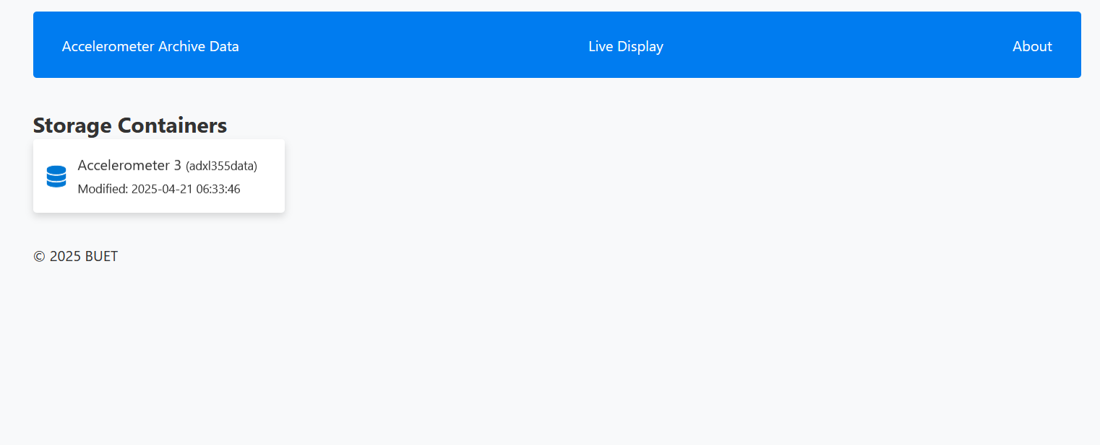
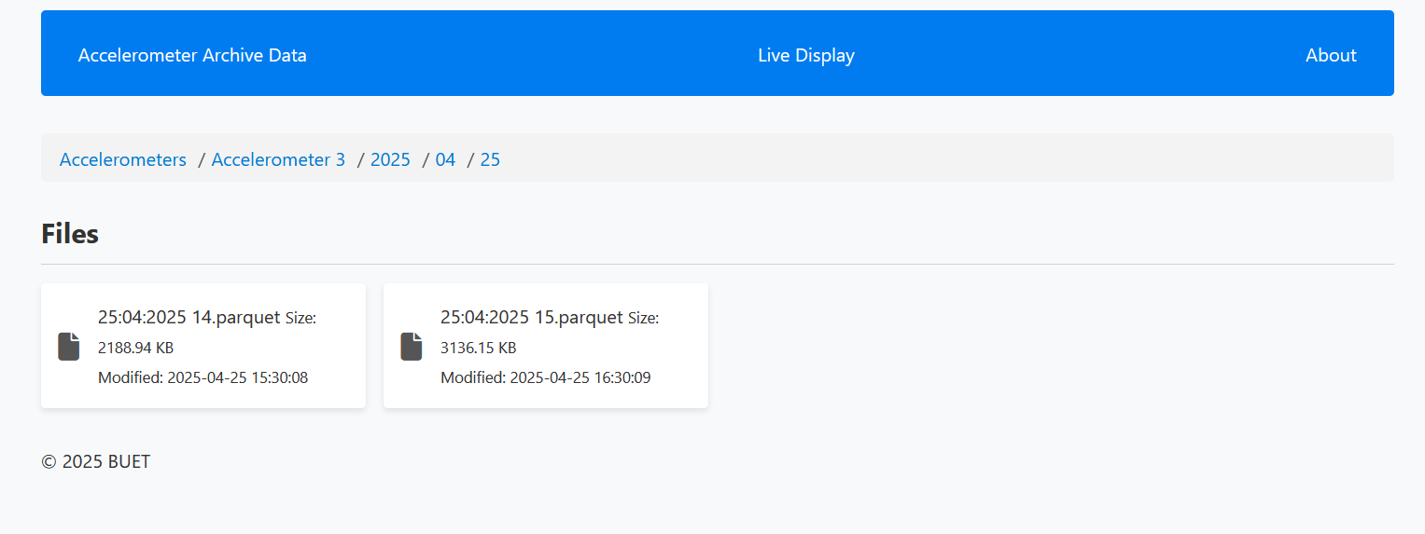
Accelerometer Data Public Server Demo
Visit: http://52.175.23.51

Slide 23
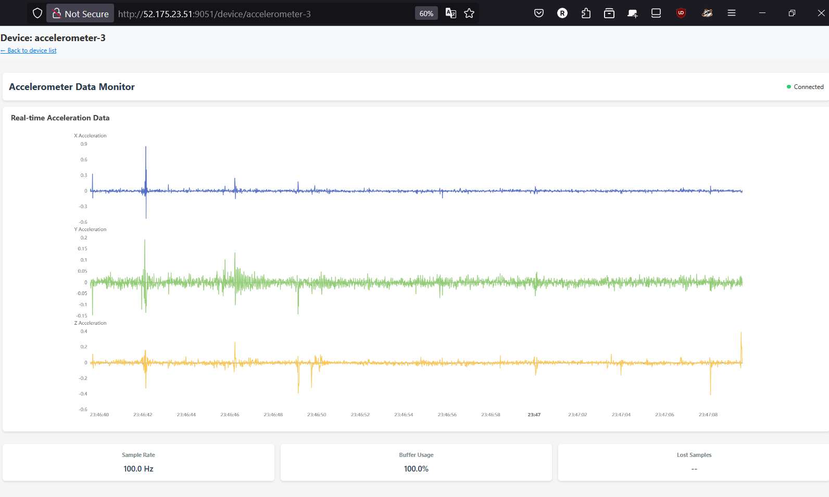
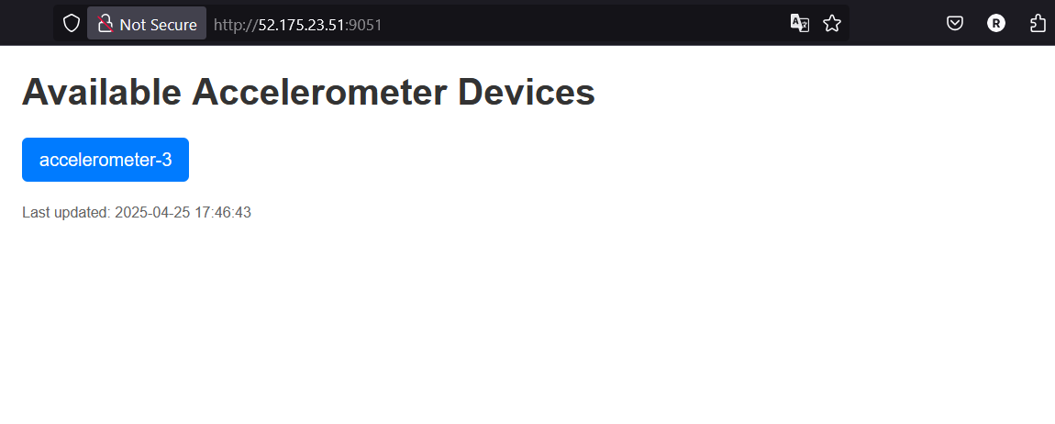
Accelerometer Data Realtime Visualization Public Server
Visit: http://52.175.23.51:9051

Slide 24
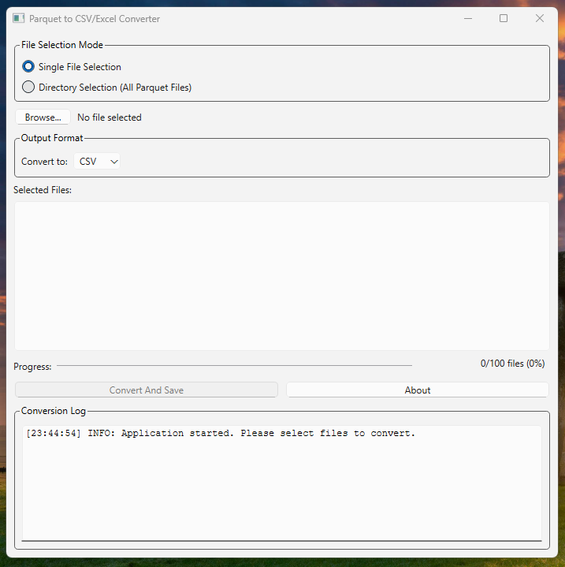
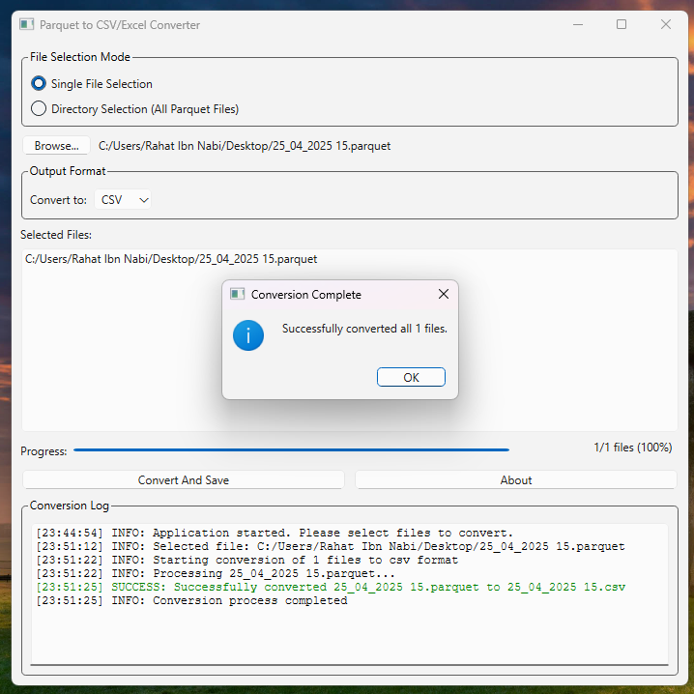
File Converter GUI Application(Demo)

Slide 25
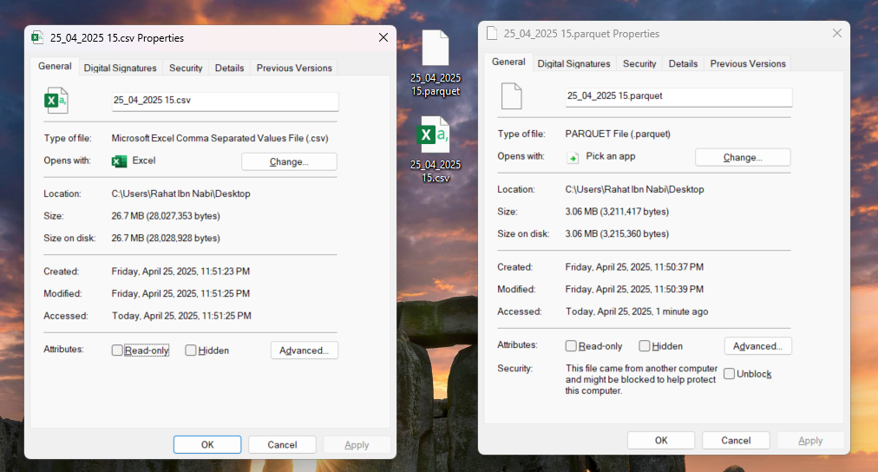
File Converter GUI Application(Demo)

Slide 26
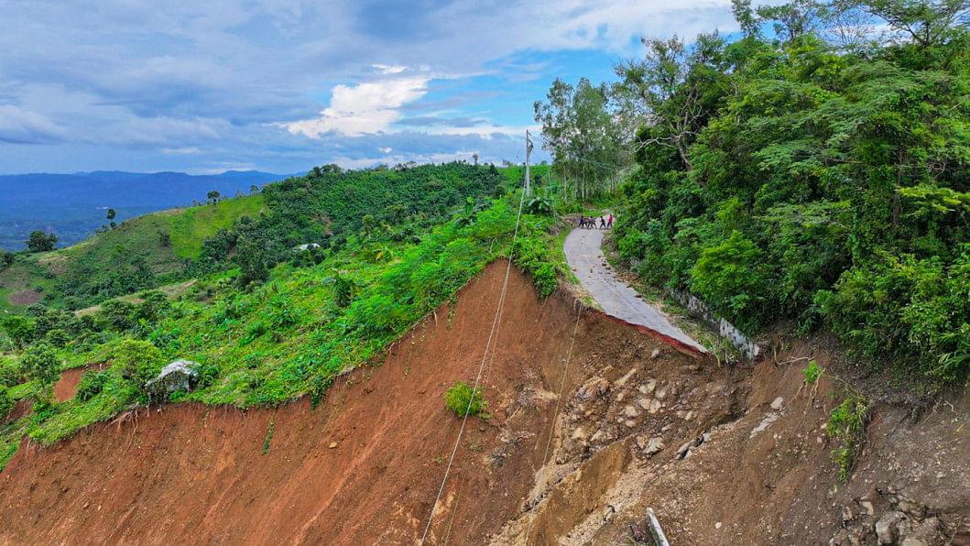
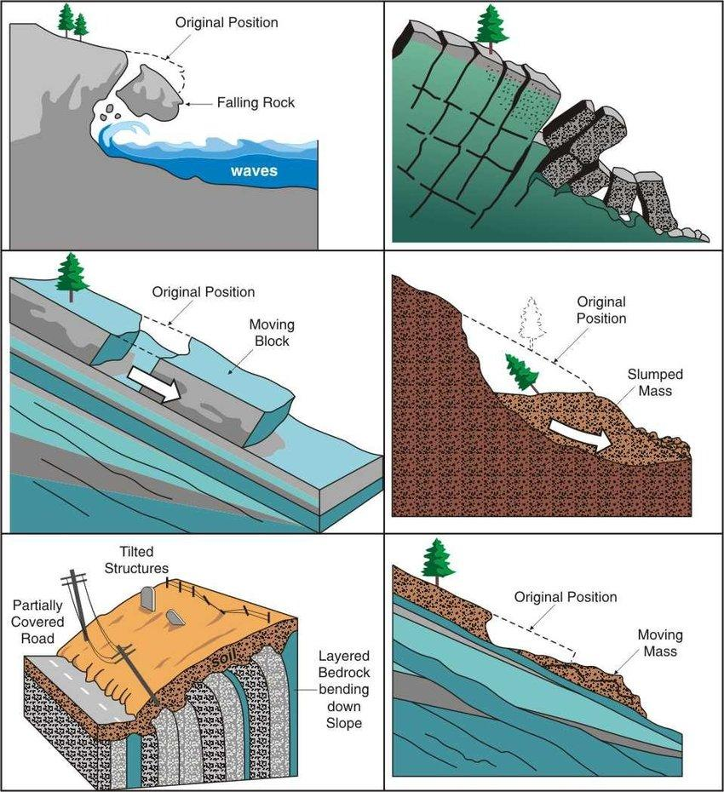
Soil Movement
Land Slide in Bangladesh
Different Types of Slope Movement from the Government of British Columbia

Slide 27
Inclinometer
An inclinometer measures lateral displacement by detecting tilt angles over a known length.
Two types of inclinometer by direction:
vertical
horizontal
Two types of inclinometer by operation:
Manual
In-place

Slide 28
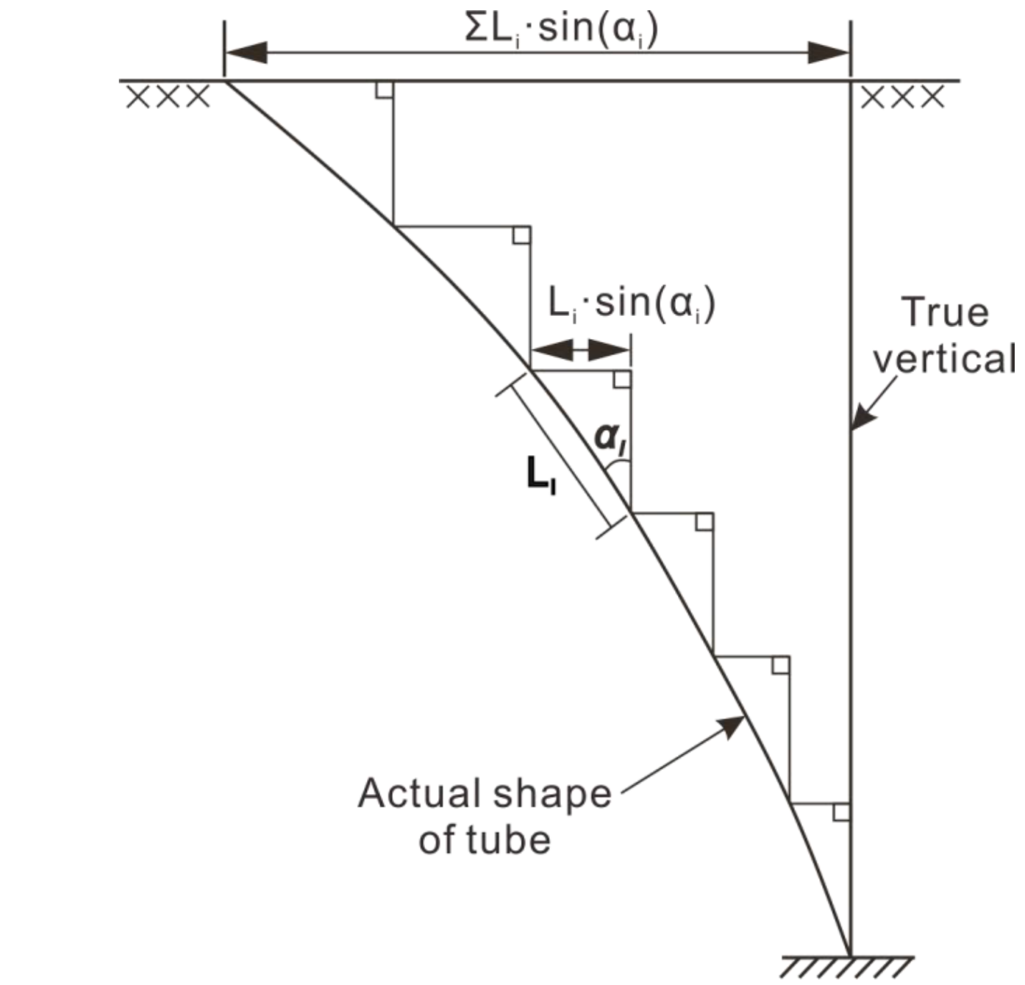

Slide 29
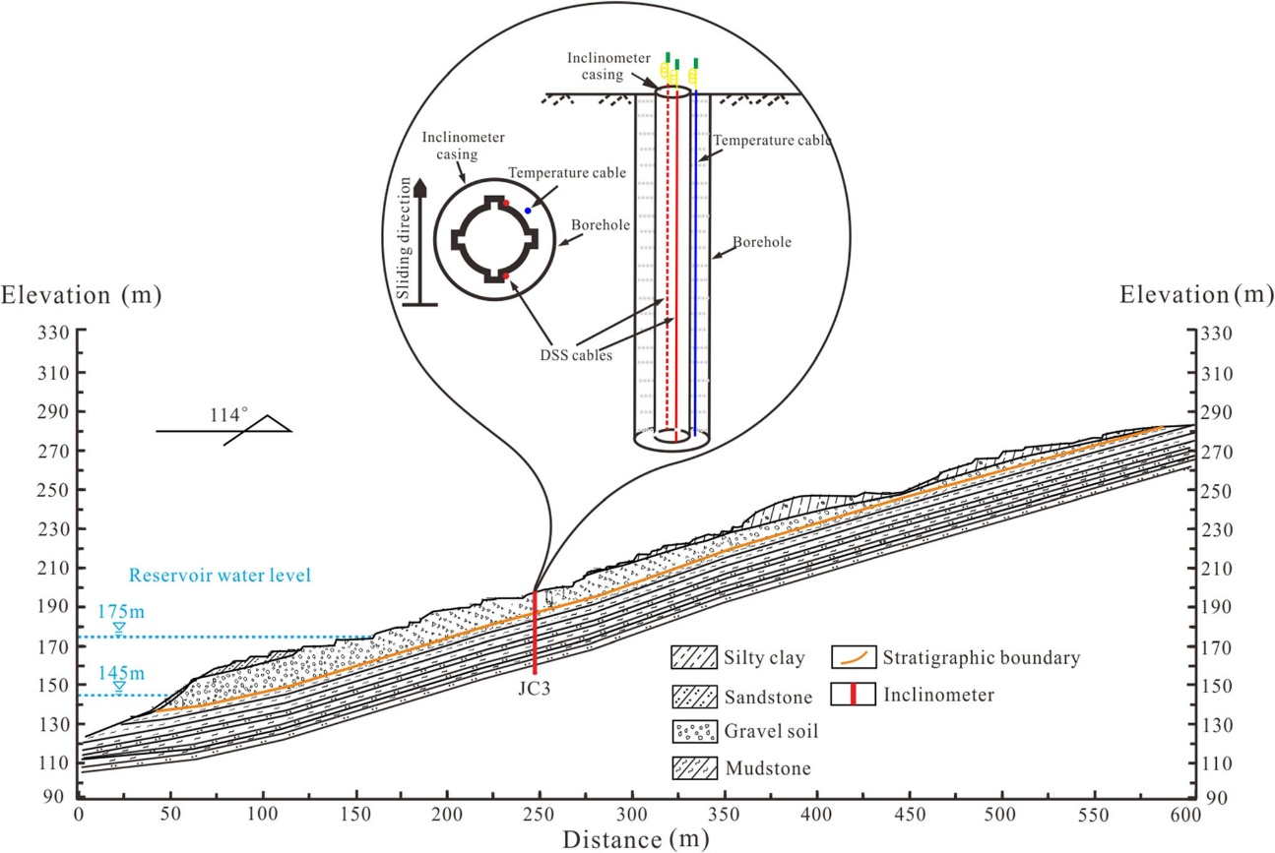
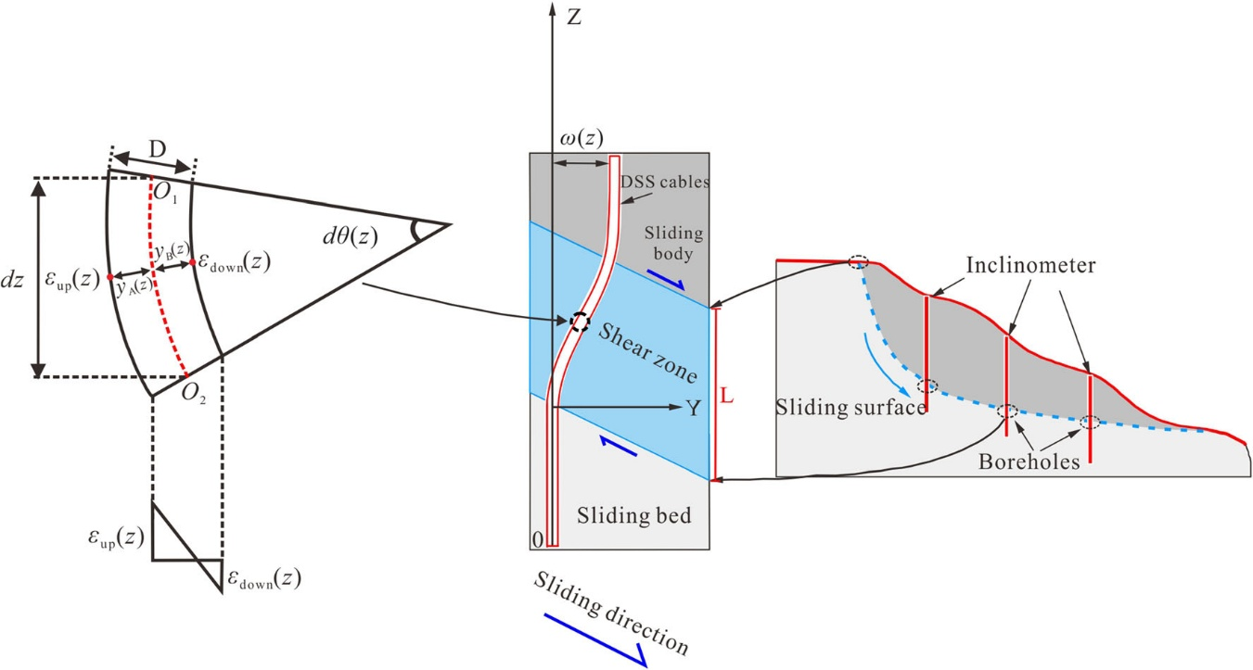
Casing Installation

Slide 30
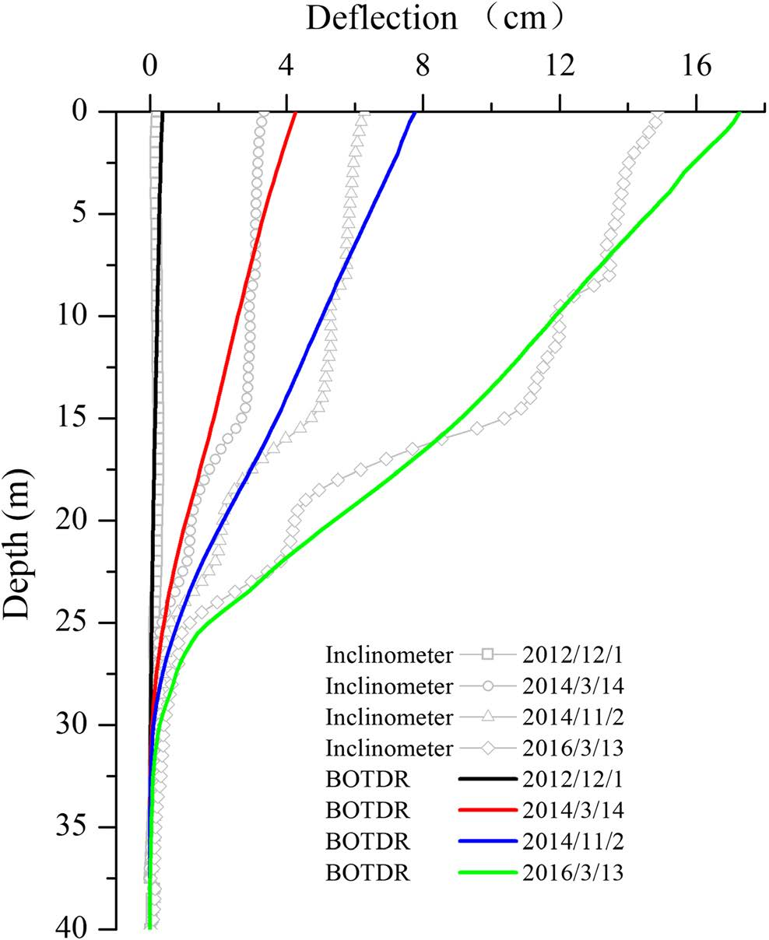
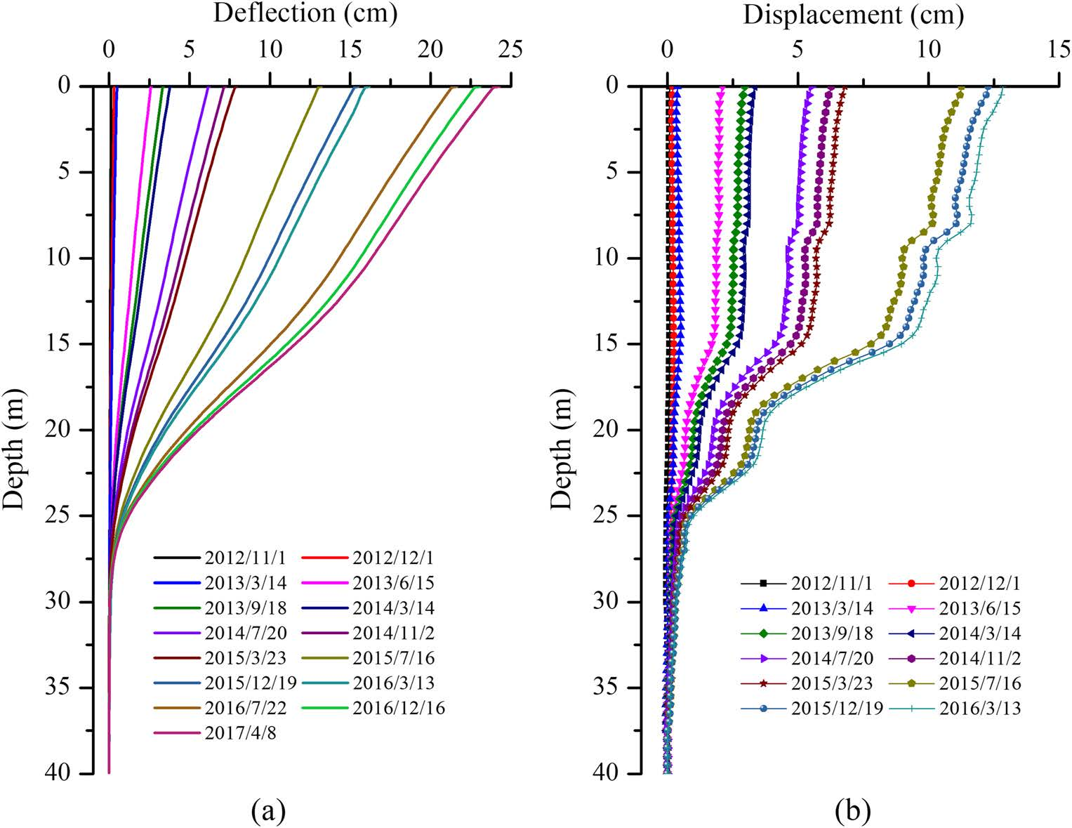
Reading Over Time

Slide 31
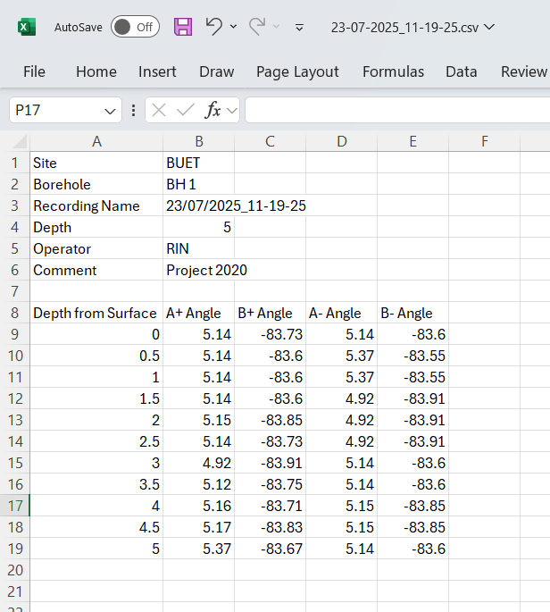
Sample Data from BLCI DL

